Slide 1

Offensive Events During a Power Play

Slide 2
agenda
1. Initial Data Insights
2. Puck Clearing
3. Main Analysis
4. Players
5. Main Takeaways
6. Assumptions

Slide 3

The Team

Slide 4
Initial Data Insights: Choosing data
Useful data: time, location of player during event, players on ice
Unknown data: type of event (i.e. pass, shot, goal, hit), location of puck/player at a general time
Location and time parameters can calculate a cleared puck from the opposing penalty kill (puck moving to center ice passing the blue line)
Due to offside rules, clearing the puck forces the offensive team to regroup, taking 10-30 seconds of time and changing momentum of the play
Notes:
How we decoded the data, what to use, what to throw away.

Slide 5

What events lead to the puck being cleared on a power play?

Slide 6
Puck Clearing: Recognizing a Cleared Puck
Clearances will be defined as the point where the puck enters center ice from crossing the blue line
The following is a puck-tracker programed in MatLab for the first game of the dataset but may be used for any general set in 'CanucksFullData'
Legend
X :Point Preceding Clearance
--- :Puck/Player Location

Slide 7
Quick Definitions
Clearance Event
When the puck goes past the blue line of the offensive zone
Turnover Event
The event prior to a clearance event, attributed to the last offensive player prior to the clearance event
Offensive Zones
See Diagram

Slide 8
Analysis
What we're looking for
Which players and what areas of the offensive zone lead to the puck being cleared?
Quick definitions
What we found

Slide 9
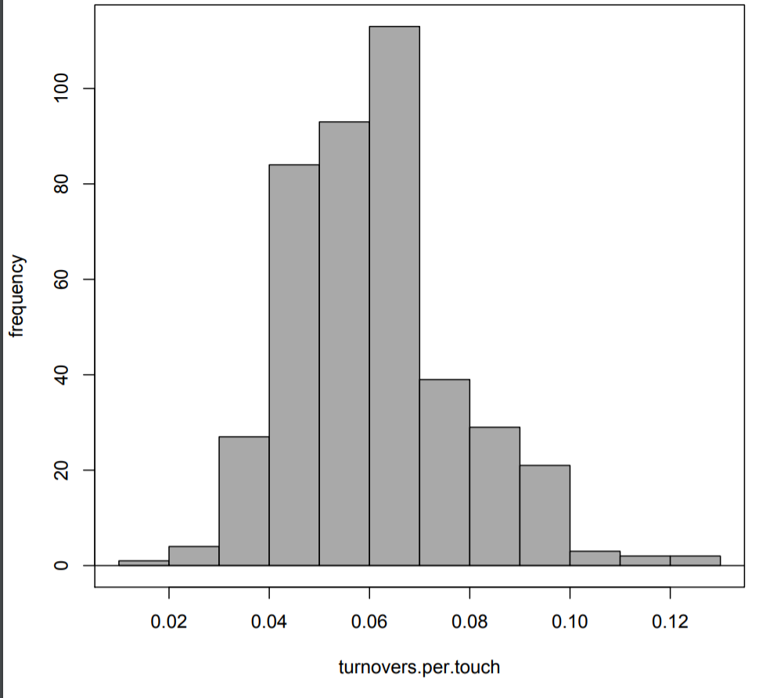
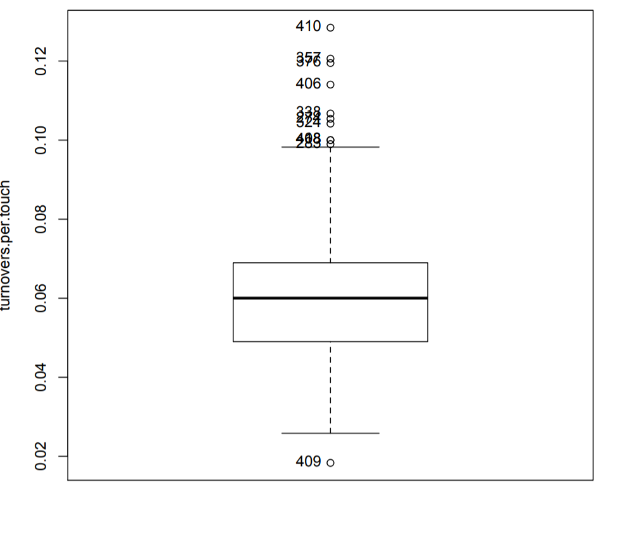
Insights: Player Turnover Distribution
Mean: 0.0610
S.D.: 0.0168
IQR: 0.0199
0%: 0.0183
25%: 0.0490
50%: 0.0600
75%: 0.0689
100%: 0.1284
N=418

Slide 10
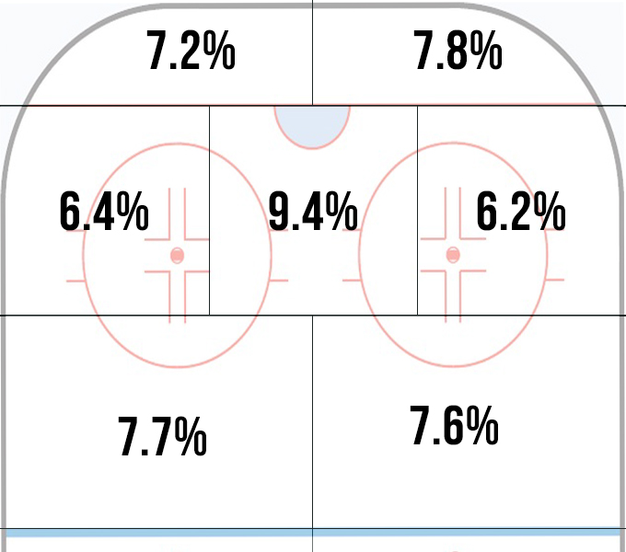
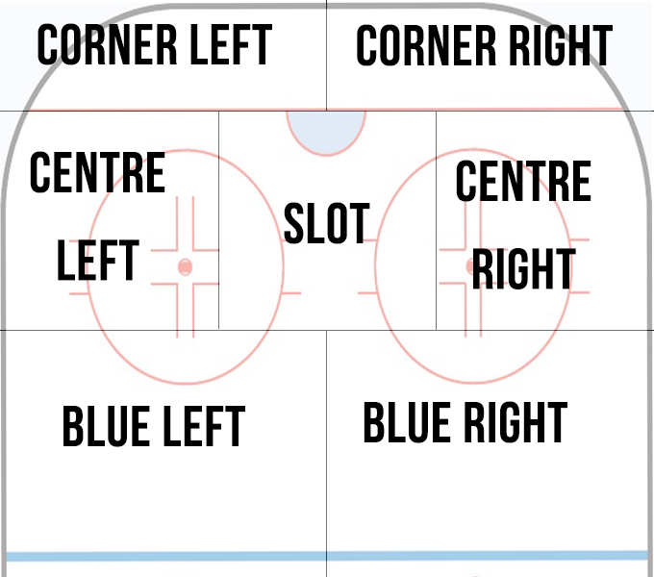
Insights: Zones

Slide 11
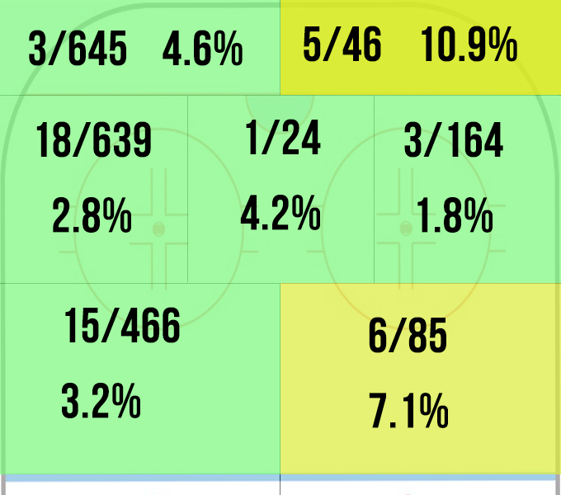
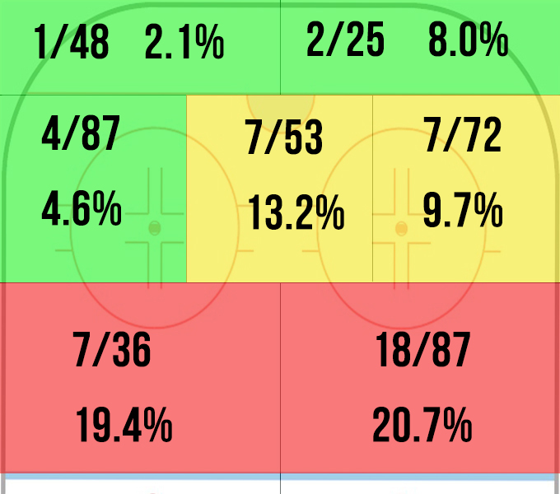
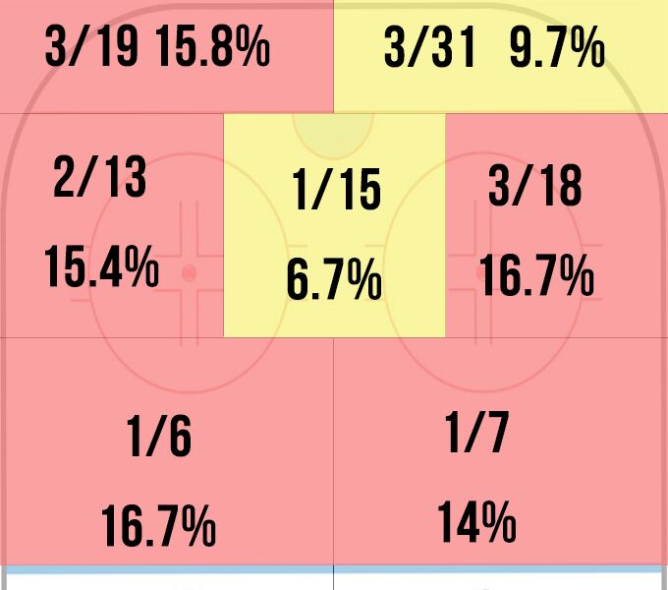
Insights: Players and Zones
Player A
Player B
Player C

Slide 12
Results Summary
Zone Statistics
Players Statistics Vary
Player Turnovers by Zone

Slide 13
Implications
1. Insights from limited data
2. Player Zone Clearance Map
3. Tools used: Puck Tracker, Heatmap

Slide 14
Thanks!
Any questions ?

Slide 15
Assumptions
Penalties happen more than 20 seconds apart
Each data line is a “touch”. Players are given more touches for skating with the puck for longer
Players with more than 100 offensive touches
Removed faceoffs

Slide 16
Follow Ups
Compare with qualitative data
See if players that turn the puck over score more
Compare by position (Forwards at blueline are breaking in. Defencemen at blueline are pinching)

